Slide 1
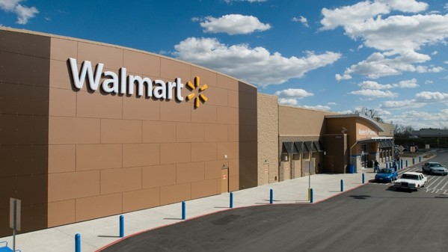
Project Done by
Rebbufred RJ
Walmart Superstore
Sales Analysis

Slide 2
OBJECTIVES
Visualization
SWOT
Strategy
Presenting the upper management the insights in the form of suitable charts
Identifying the strength, weakness, opportunities and threats
Devising suitable strategy for the top as well as low performers

Slide 3
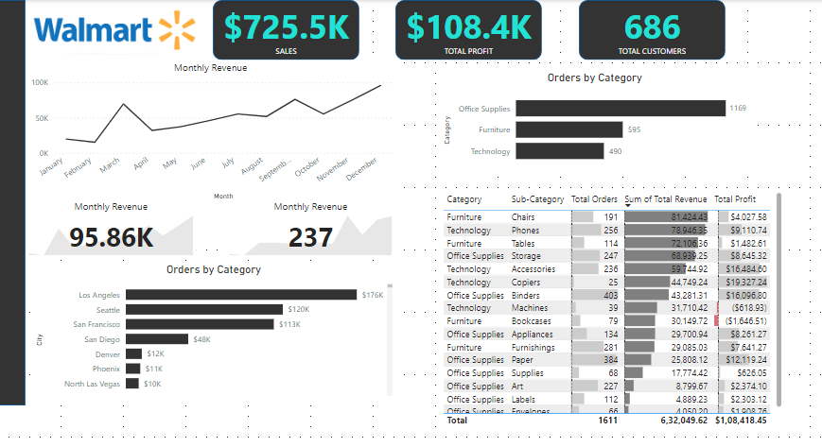
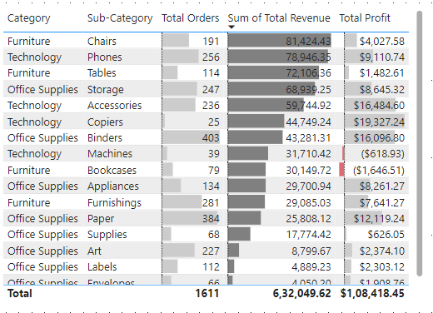
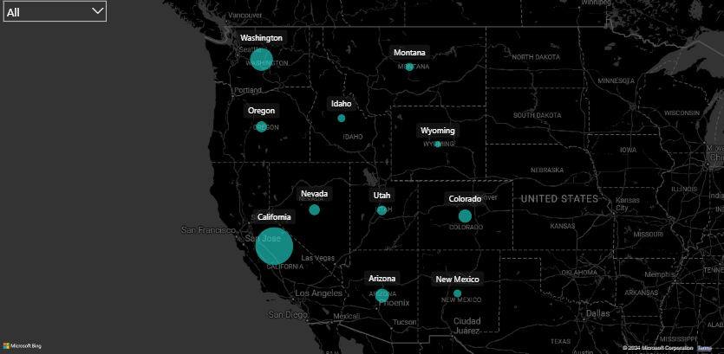
From the dashboard, we can see the trend of each and every products. From this, we can conclude with following things
Most selling product Category
Most selling city
Total customers
Total Profit
Office Supplies (1169 units)
Los Angeles($176K)
686 customers
$108.4K

Slide 4
SWOT
This contains the SWOT and root cause analysis for the sales data.
S
W
O
T
Strength
Weakness
Opportunities
Threats
Location: Los Angeles, Seattle, San Francisco
Products: Office supplies, Furniture
Location: Sales in the Midwest states has been low
Products: Technology
Location: Eastern States and Southern States
Products: Office Supplies, Furniture and Technology
Location: New Mexico
Products: All categories
CANVA CORPORATION

Slide 5

STRATEGY
TOP PERFORMERS
LOW PERFORMERS
From the analysis, we can see that California results for approximately 24% of the total sales. So by playing volume game, we can increase the sales.
Our products have less sales in many midwestern and eastern states. So, in order to boost sales there, we should focus more on marketing via digital channels and should give a location based discount..
Also the office supplies are the top contributors. So, in order to increase further more, out sales team must focus more on closing deals with MNC’s.
Since technology related products are sold less, we should provide discounts to the IT firms and various startups in order to boost sales..
CANVA CORPORATION

Slide 6
THANK YOU

